Slide 1
Unit 16
Conflict Resolution

Slide 2
Unit 16
Introduction
Conflict: Functional or Dysfunctional
Conflicts: Types and Forms
Sources of Conflict
Conflict Process
Styles of Conflict Management

Slide 3
Introduction
Conflict is an inevitable part of personal, organizational and societal life.
We all experience conflict of one kind or the others in our life, group organization and society, Conflicts arise due to competition, differences in values, attitudes, experiences, goals and perception of limited resources.
Notes:
Introduction
Conflict is an inevitable part of personal, organizational and societal life. We all experience conflict of one kind or the others in our life, group organization and society, Conflicts arise due to competition, differences in values, attitudes, experiences, goals and perception of limited resources. For example, your spouse wants you to make a visit to your in-laws' place on coming Sunday and you have plans of organizing a picnic during same time with your office colleagues. You and your boss don't agree on the amount of budget the project requires or you and your colleagues have different ideas on how to implement new performance management system. Similarly, Pepsi and Coke are fighting to capture same customer base indulge into such advertising campaign that reflect their conflict. Interstate conflict on share water resources Kauvery water sharing dispute is well known between Tamilnadu and Karnataka and water sharing of Yamuna among Delhi, UP and Haryana. Similarly, conflict between. India and Pakistan on Kashmir issue is well known. The scope of conflict resolution can be far and wide, we shall focus on interpersonal, group, intergroup, and organizational conflicts in this unit. To set the tone of the unit we would like to quote Professor Kelly(1970) " Perfect organizational health is not from freedom from conflict. On the contrary, if properly handled, conflicts can lead to more effective and appropriate adjustments"
There is no dearth of definition of conflict. The common theme in all definitions are two or more competing goals, ideas, attitudes, behaviours of one or more parties are perceived in disagreement and feeling of aversely affected interests. Taking these points, let us define conflict as a process where one party perceives that another party has adversely affected or has tried to affect adversely something that the first party values.
This definition is quite broad and can explain all the interpersonal, intergroup, and interorganizational conflicts. For example, conflicts of egos between two colleagues can be explained in terms of the process where Colleague A values his self respect. Colleague B says something which is derogatory for A, then A perceives that B has adversely affected (by derogatory remarks) something that the first party values (Ego/self respect). Similarly, intergroup situation, if another colleague from different department has persuaded the CEO to divert the portion of budget from your department to his conflict situation arises. In this situation the act of persuading the CEO divert the portion of the budget of your department( which you valued) is an adverse action leading to conflict. Similarly, organizational and societal conflicts can also be explained

Slide 4
Introduction
You and your boss don't agree on the amount of budget the project requires or you and your colleagues have different ideas on how to implement new performance management system.
Similarly, Pepsi and Coke are fighting to capture same customer base indulge into such advertising campaign that reflect their conflict.
Notes:
Introduction
Conflict is an inevitable part of personal, organizational and societal life. We all experience conflict of one kind or the others in our life, group organization and society, Conflicts arise due to competition, differences in values, attitudes, experiences, goals and perception of limited resources. For example, your spouse wants you to make a visit to your in-laws' place on coming Sunday and you have plans of organizing a picnic during same time with your office colleagues. You and your boss don't agree on the amount of budget the project requires or you and your colleagues have different ideas on how to implement new performance management system. Similarly, Pepsi and Coke are fighting to capture same customer base indulge into such advertising campaign that reflect their conflict. Interstate conflict on share water resources Kauvery water sharing dispute is well known between Tamilnadu and Karnataka and water sharing of Yamuna among Delhi, UP and Haryana. Similarly, conflict between. India and Pakistan on Kashmir issue is well known. The scope of conflict resolution can be far and wide, we shall focus on interpersonal, group, intergroup, and organizational conflicts in this unit. To set the tone of the unit we would like to quote Professor Kelly(1970) " Perfect organizational health is not from freedom from conflict. On the contrary, if properly handled, conflicts can lead to more effective and appropriate adjustments"
There is no dearth of definition of conflict. The common theme in all definitions are two or more competing goals, ideas, attitudes, behaviours of one or more parties are perceived in disagreement and feeling of aversely affected interests. Taking these points, let us define conflict as a process where one party perceives that another party has adversely affected or has tried to affect adversely something that the first party values.
This definition is quite broad and can explain all the interpersonal, intergroup, and interorganizational conflicts. For example, conflicts of egos between two colleagues can be explained in terms of the process where Colleague A values his self respect. Colleague B says something which is derogatory for A, then A perceives that B has adversely affected (by derogatory remarks) something that the first party values (Ego/self respect). Similarly, intergroup situation, if another colleague from different department has persuaded the CEO to divert the portion of budget from your department to his conflict situation arises. In this situation the act of persuading the CEO divert the portion of the budget of your department( which you valued) is an adverse action leading to conflict. Similarly, organizational and societal conflicts can also be explained

Slide 5
Introduction
There is no dearth of definition of conflict.
The common theme in all definitions are two or more competing goals, ideas, attitudes, behaviours of one or more parties are perceived in disagreement and feeling of aversely affected interests.
let us define conflict as a process where one party perceives that another party has adversely affected or has tried to affect adversely something that the first party values.
Notes:
Introduction
Conflict is an inevitable part of personal, organizational and societal life. We all experience conflict of one kind or the others in our life, group organization and society, Conflicts arise due to competition, differences in values, attitudes, experiences, goals and perception of limited resources. For example, your spouse wants you to make a visit to your in-laws' place on coming Sunday and you have plans of organizing a picnic during same time with your office colleagues. You and your boss don't agree on the amount of budget the project requires or you and your colleagues have different ideas on how to implement new performance management system. Similarly, Pepsi and Coke are fighting to capture same customer base indulge into such advertising campaign that reflect their conflict. Interstate conflict on share water resources Kauvery water sharing dispute is well known between Tamilnadu and Karnataka and water sharing of Yamuna among Delhi, UP and Haryana. Similarly, conflict between. India and Pakistan on Kashmir issue is well known. The scope of conflict resolution can be far and wide, we shall focus on interpersonal, group, intergroup, and organizational conflicts in this unit. To set the tone of the unit we would like to quote Professor Kelly(1970) " Perfect organizational health is not from freedom from conflict. On the contrary, if properly handled, conflicts can lead to more effective and appropriate adjustments"
There is no dearth of definition of conflict. The common theme in all definitions are two or more competing goals, ideas, attitudes, behaviours of one or more parties are perceived in disagreement and feeling of aversely affected interests. Taking these points, let us define conflict as a process where one party perceives that another party has adversely affected or has tried to affect adversely something that the first party values.
This definition is quite broad and can explain all the interpersonal, intergroup, and interorganizational conflicts. For example, conflicts of egos between two colleagues can be explained in terms of the process where Colleague A values his self respect. Colleague B says something which is derogatory for A, then A perceives that B has adversely affected (by derogatory remarks) something that the first party values (Ego/self respect). Similarly, intergroup situation, if another colleague from different department has persuaded the CEO to divert the portion of budget from your department to his conflict situation arises. In this situation the act of persuading the CEO divert the portion of the budget of your department( which you valued) is an adverse action leading to conflict. Similarly, organizational and societal conflicts can also be explained

Slide 6
Conflict: Functional Or Dysfunctional
Conflicts are not always dysfunctional.
In fact conflicts many times force people generate more acceptable and win-win solutions, thus in the process lead to creative solutions.
In order to reduce tendency of conformity and stimulate creative thinking Tata Steel had released message on encourage dissent.
Notes:
Conflicts are not always dysfunctional. In fact conflicts many times force people generate more acceptable and win-win solutions, thus in the process lead to creative solutions. In order to reduce tendency of conformity and stimulate creative thinking Tata Steel had released message on encourage dissent. However, if conflicts not handled properly may lead to latent hostility, frustration and poor performance. Thus managers need to encourage positive conflicts and prevent or manage negative conflicts.

Slide 7
Conflict: Functional Or Dysfunctional
Functional Conflict:
It is healthy disagreement between two or more parties.
In functional conflicts, people primarily differ on ideas or perceptions.
If people are open minded they make joint exploration on ideas or principles, new awareness, new insight which improves the relationship between parties to disagreement.
Notes:
Functional Conflict: It is healthy disagreement between two or more parties. In functional conflicts, people primarily differ on ideas or perceptions. If people are open minded they make joint exploration on ideas or principles, new awareness, new insight which improves the relationship between parties to disagreement. Functional conflicts lead to innovation and creativity, thus open possibility for high performance and organizational improvement. Typically, functional conflicts originate from cognitive or idea level difference rather than from affect .

Slide 8
Conflict: Functional Or Dysfunctional
Dysfunctional Conflict:
It is unhealthy disagreement between two or more parties.
Traditional view of conflict is more known for its dysfunctional nature.
It presumes that conflicts are inherently bad and invariably affect the organizational outcome negatively.
Notes:
Dysfunctional Conflict: It is unhealthy disagreement between two or more parties. Traditional view of conflict is more known for its dysfunctional nature. It presumes that conflicts are inherently bad and invariably affect the organizational outcome negatively. It involves anger, frustration, hostility, and antagonism among the parties and most often parties to the conflict engage in win-lose or lose-lose game.
Managers find it difficult to identify whether a conflict is functional or dysfunctional. DL Nelson and JC Quick (2000) suggest using following questions to diagnose as to whether a conflict is functional or dysfunctional:
Are the parties to conflict hostile to each other?
Is the outcome likely to be negative one for the organization?
Do the potential losses of the parties exceed any potential gains?
Is energy being diverted from goal accomplishment?
If the majority of these questions have yes as answers, then you are probably faced with dysfunctional conflict. Such conflict needs be resolved on urgent basis. If answers to these questions are negative, then you may be in the zone of functional conflict which you can choose to stimulate. Another situation when you as a manager would like to stimulate conflict is when group is in the process of groupthink and is not willing to examine various alternatives and its creativity has gone down.

Slide 9
Conflict: Functional Or Dysfunctional
Dysfunctional Conflict:
A conflict is functional or dysfunctional:
Are the parties to conflict hostile to each other?
Is the outcome likely to be negative one for the organization?
Do the potential losses of the parties exceed any potential gains?
Is energy being diverted from goal accomplishment?
Notes:
Dysfunctional Conflict: It is unhealthy disagreement between two or more parties. Traditional view of conflict is more known for its dysfunctional nature. It presumes that conflicts are inherently bad and invariably affect the organizational outcome negatively. It involves anger, frustration, hostility, and antagonism among the parties and most often parties to the conflict engage in win-lose or lose-lose game.
Managers find it difficult to identify whether a conflict is functional or dysfunctional. DL Nelson and JC Quick (2000) suggest using following questions to diagnose as to whether a conflict is functional or dysfunctional:
Are the parties to conflict hostile to each other?
Is the outcome likely to be negative one for the organization?
Do the potential losses of the parties exceed any potential gains?
Is energy being diverted from goal accomplishment?
If the majority of these questions have yes as answers, then you are probably faced with dysfunctional conflict. Such conflict needs be resolved on urgent basis. If answers to these questions are negative, then you may be in the zone of functional conflict which you can choose to stimulate. Another situation when you as a manager would like to stimulate conflict is when group is in the process of groupthink and is not willing to examine various alternatives and its creativity has gone down.

Slide 10
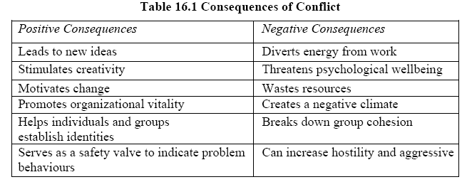
Conflict: Functional Or Dysfunctional
Dysfunctional Conflict:

Slide 11
Conflicts: Types and Forms
There are a number of classificatory schemes to group various types of conflicts.
One we have already mentioned: functional versus dysfunctional conflicts.
Similar classifications have been made by many researchers.
Notes:
Conflicts: Types and Forms
There are a number of classificatory schemes to group various types of conflicts. One we have already mentioned: functional versus dysfunctional conflicts. Similar classifications have been made by many researchers. For example: Haiman suggested intrinsic vs extrinsic conflicts. Extrinsic conflict has psychological and emotional content while intrinsic conflicts consists of rational, ideational, or intellectual contents. Resolving intrinsic. conflicts requires analytical approach and skill while extrinsic conflict requires social tact and diplomacy.
Realistic vs Non-realistic Conflicts. Coser proposed this classification. Similar to Haiman's classification, realistic conflicts have rational, task or goal oriented confrontations whereas non-realistic conflicts are in noway related to goals or tasks of the group and organization. It consists of projected frustrations and emotions. For example, I have some problem or frustration at home and I decide to take it out on the group, thus non-realistic,
Substantive vs Affective Conflicts. Guetzko and Gyr proposed this classification. According to them substantive conflicts are task related conflicts whereas affective conflicts are related to socio-emotional or interpersonal relations issues.

Slide 12
Conflicts: Types and Forms
Realistic vs Non-realistic Conflicts. Coser proposed this classification.
Similar to Haiman's classification, realistic conflicts have rational, task or goal oriented confrontations whereas non-realistic conflicts are in noway related to goals or tasks of the group and organization.
It consists of projected frustrations and emotions
Notes:
Conflicts: Types and Forms
There are a number of classificatory schemes to group various types of conflicts. One we have already mentioned: functional versus dysfunctional conflicts. Similar classifications have been made by many researchers. For example: Haiman suggested intrinsic vs extrinsic conflicts. Extrinsic conflict has psychological and emotional content while intrinsic conflicts consists of rational, ideational, or intellectual contents. Resolving intrinsic. conflicts requires analytical approach and skill while extrinsic conflict requires social tact and diplomacy.
Realistic vs Non-realistic Conflicts. Coser proposed this classification. Similar to Haiman's classification, realistic conflicts have rational, task or goal oriented confrontations whereas non-realistic conflicts are in noway related to goals or tasks of the group and organization. It consists of projected frustrations and emotions. For example, I have some problem or frustration at home and I decide to take it out on the group, thus non-realistic,
Substantive vs Affective Conflicts. Guetzko and Gyr proposed this classification. According to them substantive conflicts are task related conflicts whereas affective conflicts are related to socio-emotional or interpersonal relations issues.

Slide 13
Conflicts: Types and Forms
Substantive vs Affective Conflicts. Guetzko and Gyr proposed this classification.
According to them substantive conflicts are task related conflicts whereas affective conflicts are related to socio-emotional or interpersonal relations issues.
Notes:
Conflicts: Types and Forms
There are a number of classificatory schemes to group various types of conflicts. One we have already mentioned: functional versus dysfunctional conflicts. Similar classifications have been made by many researchers. For example: Haiman suggested intrinsic vs extrinsic conflicts. Extrinsic conflict has psychological and emotional content while intrinsic conflicts consists of rational, ideational, or intellectual contents. Resolving intrinsic. conflicts requires analytical approach and skill while extrinsic conflict requires social tact and diplomacy.
Realistic vs Non-realistic Conflicts. Coser proposed this classification. Similar to Haiman's classification, realistic conflicts have rational, task or goal oriented confrontations whereas non-realistic conflicts are in noway related to goals or tasks of the group and organization. It consists of projected frustrations and emotions. For example, I have some problem or frustration at home and I decide to take it out on the group, thus non-realistic,
Substantive vs Affective Conflicts. Guetzko and Gyr proposed this classification. According to them substantive conflicts are task related conflicts whereas affective conflicts are related to socio-emotional or interpersonal relations issues.

Slide 14
Conflicts: Types and Forms
Conflicts of both kind can occurs over various kind of issues. Morton and, Deutsch suggest five such issues:
Resources: control of money, property, space, power etc.
Preferences and nuisances
Value
Beliefs, and
Nature of relationship between parties
Notes:
Conflicts of both kind can occurs over various kind of issues. Morton and, Deutsch suggest five such issues:
Resources: control of money, property, space, power etc.
Preferences and nuisances
Value
Beliefs, and
Nature of relationship between parties
Deutsch also proposed six types of conflict which may occur across the issues any time and in combination.
Veridical Conflict. This type of conflict exists objectively and is perceived accurately. Honest but difficult difference of opinion.
Contingent Conflict. Conflict is resolvable but parties are not aware of it. A larger perspective helps
Displaced Conflict. The parties fail to identify real issue and argue over secondary issue
Misattributed Conflict. The assigning of wrong reasons, often unconsciously, to conflict.
Latent Conflict. A failure to consciously recognise that a true conflict exists
False Conflict. A conflict without basis caused by misunderstanding and poor communication
Robbins(2001) proposed a three fold classification of conflict:
Task Conflict. It relates to content and the goal of the work.
Relationship Conflict. It consists of interpersonal, emotional issues.
Process Conflict. It focuses on how the work gets done.

Slide 15
Conflicts: Types and Forms
Deutsch also proposed six types of conflict which may occur across the issues any time and in combination.
Veridical Conflict. This type of conflict exists objectively and is perceived accurately. Honest but difficult difference of opinion.
Contingent Conflict. Conflict is resolvable but parties are not aware of it. A larger perspective helps
Notes:
Conflicts of both kind can occurs over various kind of issues. Morton and, Deutsch suggest five such issues:
Resources: control of money, property, space, power etc.
Preferences and nuisances
Value
Beliefs, and
Nature of relationship between parties
Deutsch also proposed six types of conflict which may occur across the issues any time and in combination.
Veridical Conflict. This type of conflict exists objectively and is perceived accurately. Honest but difficult difference of opinion.
Contingent Conflict. Conflict is resolvable but parties are not aware of it. A larger perspective helps
Displaced Conflict. The parties fail to identify real issue and argue over secondary issue
Misattributed Conflict. The assigning of wrong reasons, often unconsciously, to conflict.
Latent Conflict. A failure to consciously recognise that a true conflict exists
False Conflict. A conflict without basis caused by misunderstanding and poor communication
Robbins(2001) proposed a three fold classification of conflict:
Task Conflict. It relates to content and the goal of the work.
Relationship Conflict. It consists of interpersonal, emotional issues.
Process Conflict. It focuses on how the work gets done.

Slide 16
Conflicts: Types and Forms
Deutsch also proposed six types of conflict which may occur across the issues any time and in combination.
Displaced Conflict. The parties fail to identify real issue and argue over secondary issue
Misattributed Conflict. The assigning of wrong reasons, often unconsciously, to conflict.
Latent Conflict. A failure to consciously recognise that a true conflict exists
Notes:
Conflicts of both kind can occurs over various kind of issues. Morton and, Deutsch suggest five such issues:
Resources: control of money, property, space, power etc.
Preferences and nuisances
Value
Beliefs, and
Nature of relationship between parties
Deutsch also proposed six types of conflict which may occur across the issues any time and in combination.
Veridical Conflict. This type of conflict exists objectively and is perceived accurately. Honest but difficult difference of opinion.
Contingent Conflict. Conflict is resolvable but parties are not aware of it. A larger perspective helps
Displaced Conflict. The parties fail to identify real issue and argue over secondary issue
Misattributed Conflict. The assigning of wrong reasons, often unconsciously, to conflict.
Latent Conflict. A failure to consciously recognise that a true conflict exists
False Conflict. A conflict without basis caused by misunderstanding and poor communication
Robbins(2001) proposed a three fold classification of conflict:
Task Conflict. It relates to content and the goal of the work.
Relationship Conflict. It consists of interpersonal, emotional issues.
Process Conflict. It focuses on how the work gets done.

Slide 17
Conflicts: Types and Forms
Deutsch also proposed six types of conflict which may occur across the issues any time and in combination.
False Conflict. A conflict without basis caused by misunderstanding and poor communication
Notes:
Conflicts of both kind can occurs over various kind of issues. Morton and, Deutsch suggest five such issues:
Resources: control of money, property, space, power etc.
Preferences and nuisances
Value
Beliefs, and
Nature of relationship between parties
Deutsch also proposed six types of conflict which may occur across the issues any time and in combination.
Veridical Conflict. This type of conflict exists objectively and is perceived accurately. Honest but difficult difference of opinion.
Contingent Conflict. Conflict is resolvable but parties are not aware of it. A larger perspective helps
Displaced Conflict. The parties fail to identify real issue and argue over secondary issue
Misattributed Conflict. The assigning of wrong reasons, often unconsciously, to conflict.
Latent Conflict. A failure to consciously recognise that a true conflict exists
False Conflict. A conflict without basis caused by misunderstanding and poor communication
Robbins(2001) proposed a three fold classification of conflict:
Task Conflict. It relates to content and the goal of the work.
Relationship Conflict. It consists of interpersonal, emotional issues.
Process Conflict. It focuses on how the work gets done.

Slide 18
Conflicts: Types and Forms
Robbins(2001) proposed a three fold classification of conflict:
Task Conflict. It relates to content and the goal of the work.
Relationship Conflict. It consists of interpersonal, emotional issues.
Process Conflict. It focuses on how the work gets done.

Slide 19
Conflicts: Types and Forms
Interorganizational Conflicts:
These are conflicts that arise between two or more organizations .
There are numerous examples of interorganizational conflicts.
These can be functional as well as dysfunctional conflicts.
When organizations, due to competition enhance their quality, the same can be treated as functional conflict.
Notes:
Interorganizational Conflicts: These are conflicts that arise between two or more organizations . There are numerous examples of interorganizational conflicts. These can be functional as well as dysfunctional conflicts. When organizations, due to competition enhance their quality, the same can be treated as functional conflict. However, if the same organizations are engaged in malicious campaign against each other, conflict will be termed as dysfunctional conflict.

Slide 20
Conflicts: Types and Forms
Intergroup Conflict:
When conflict occurs between two or more groups, departments, teams, the same is called intergroup conflict.
When there is intergroup conflict, the groups become more cohesive, task focused and members show greater loyalty.
Notes:
Intergroup Conflict: When conflict occurs between two or more groups, departments, teams, the same is called intergroup conflict. When there is intergroup conflict, the groups become more cohesive, task focused and members show greater loyalty. However the outgroup i.e., the other group is seen as an enemy, hostility and obstructing behaviour is among members negatively affecting the interest of other group. It is therefore suggested that competition must be managed carefully, and competing groups should not lose sight of super ordinate goals of organizations.

Slide 21
Conflicts: Types and Forms
Interpersonal Conflict:
Conflict between two or more individual can be considered as interpersonal conflicts.
Such conflicts may occur due to individual differences including differences in perception of problems, perception of situations, attitudes, values apart from differences arising out of control and allocation of resources.
Notes:
Interpersonal Conflict: Conflict between two or more individual can be considered as interpersonal conflicts. Such conflicts may occur due to individual differences including differences in perception of problems, perception of situations, attitudes, values apart from differences arising out of control and allocation of resources.

Slide 22
Conflicts: Types and Forms
Intrapersonal Conflicts:
When conflict occurs within a person , the same is called intrapersonal conflict.
There are several types of intrapersonal conflict including interrole, intrarole, and person-role conflict.
Role is a set of expectations put by others.
Notes:
Intrapersonal Conflicts When conflict occurs within a person , the same is called intrapersonal conflict. There are several types of intrapersonal conflict including interrole, intrarole, and person-role conflict. Role is a set of expectations put by others. Persons who are putting their expectations are called role senders and the person who is receiving set of expectations and is focus of attention is called focal person.

Slide 23
Conflicts: Types and Forms
Interrole conflict:
Interrole conflict can occur when a person is experiencing conflict due to competing demands in two roles.
An employee may be a union leader and also executive in production department.
Person's role as executive expects him to be obedient to his boss and work diligently for the organization.
Notes:
Interrole conflict can occur when a person is experiencing conflict due to competing demands in two roles. An employee may be a union leader and also executive in production department. Person's role as executive expects him to be obedient to his boss and work diligently for the organization, however his role as a union leader is to raise issues with management to further the interest of their union. By playing the two roles the person experiences interrole conflict. Intrarole conflict can occur when the persons receives contradictory expectations in the same role. For example, manager suggests an employee to finish the project by tomorrow and also suggest to visit five clients personally today itself. It is virtually impossible to finish the project by tomorrow if the employee complies to the other exoectation, i.e., visiting five clients personally today itself. This may generate intrapersonal conflict.
Person-role conflict occurs when a person is expected to do certain thing as a part of his/her role, which is against personal value system. For example, a person strongly feels about environmental pollution. She is asked to defend act of unguarded pollution of her company to the Government officials. Such expectation put her in the person-role conflict.

Slide 24
Sources of Conflict
Conflicts arise from many sources. These sources of conflict can be classified in may ways.
For example, personal and organizational sources or role, goal, resource and structural sources of conflict.
Pareek has proposed seven main sources of interpersonal and intergroup conflict.
The following table presents as to how parties perceive the sources of conflict under escalation and resolution mode.
Notes:
Conflicts arise from many sources. These sources of conflict can be classified in may ways. For example, personal and organizational sources or role, goal, resource and structural sources of conflict. Pareek has proposed seven main sources of interpersonal and intergroup conflict. The following table presents as to how parties perceive the sources of conflict under escalation and resolution mode.
The first source of conflict is selfish concern which generate narrow short term orientation. Parties are interested only in self-interest. This approach actually does not help the individual as the organization or group is likely to remain unless the parties to the conflict broaden their perspective and attain what Sheriff and Sheriff called "super-ordinate goals' but can not be attained by any one member/ party alone. Superordinate goals are those goals that are necessary for all members in the group. Superordinate goals can't be attained by one individual, it can be attained only by collective efforts of all members.

Slide 25
Sources of Conflict
The first source of conflict is selfish concern which generate narrow short term orientation.
Parties are interested only in self-interest. This approach actually does not help the individual as the organization or group is likely to remain unless

Slide 26
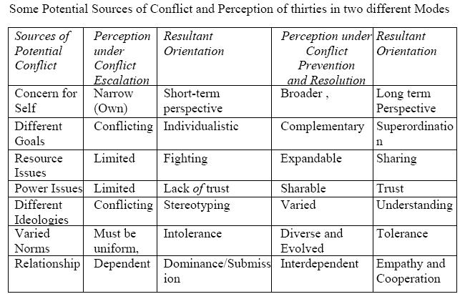
Conflicts: Types and Forms

Slide 27
Conflicts: Types and Forms
When two members of the group are pursuing goals that are mutually exclusive conflict is bound to be there.
If the outcome of conflict is very critical, person may develop individualistic orientation.
Better way is to see things from wider perspective where multiple goals can be pursued simultaneously and goals can be developed that are complementary.
Notes:
When two members of the group are pursuing goals that are mutually exclusive conflict is bound to be there. If the outcome of conflict is very critical, person may develop individualistic orientation. Better way is to see things from wider perspective where multiple goals can be pursued simultaneously and goals can be developed that are complementary. For example some member may have power need, and pursuing the goal of influencing and persuading people where another person's need may be share his experiences with the group. The two goals apparently seems to be contradictory, but can be pursued simultaneously. One can take gate keeping role to regulate group functioning while another member can find appropriate time to share his own experience with the group. Group also needs people who are ready to subordinate their personal goals for the group's goal.
Resource sharing has been a perennial cause conflict within and between groups. It happens because members of the groups feel that resources are limited and they need to take control of resources to the exclusion of other member/ group. In resolution mode, groups jointly act to expand the resources or at least agree to share resources. Such approach saves a lot of energy of the group normally wasted while fighting.
Power has also been source of conflict and people and groups perceive it to be limited. For example, the departmental headship is a position of power as the head takes all the decisions regarding resource allocation, rule formulation etc, Such exercise of power gives birth to conflict, frustration and hostility. Sharing of, power through various committees and participation may give the perception that power is sharable and resultant orientation will be trust.
Ideologies can be different but people can still decide to live peacefully. If people are too intolerant to opposite ideologies, people may react stereotypically towards persons of different ideology. If people work on preventative mode they recognise the diversity of the group and organization and try to interact with understanding instead of showing hostility.
Group norms may also be a cause of conflict. Many times one group is not tolerated by another because the two follow different norms. The dominant group most often tries trust its norms on the weaker group and advocates for uniform norms. This develops the orientation of intolerance. If groups are working in preventive/resolution mode they consider that groups can be autonomous and have their own norms and thus develop a sense of tolerance. Example, person from majority community if insist that minority community must follow its norms the orientation is intolerance. However, more sensible majority community members try to prevail upon members of their community to not to insist on minority community change its norms and thus develops sense of tolerance.
Relationship within and among groups may be a source of conflict. Some people/ groups have tendency to dominate. Others are comfortable with dependence and hierarchical relationship. Similarly some people prefer to relate on equality basis and feel uncomfortable in hierarchical relationship. When relationship is an issue and one party wants to create dependence in other group, the resultant orientation is dominance by one and submission by another. Better way for dealing with situation is to see the relationship in terms of interdependence (A depends on B for fulfilling certain needs, similarly B depends on A for some other things). Such relationship develops appreciation for mutual need sand the resultant orientation is empathy and cooperation.
To summarise, if people are too much interested only in their own needs, want to their own goals at all costs, fight to capture available resources, distrust powerholders, stereotype people with different ideologies, show intolerance for different norms, and try to dominate other, conflict will surely escalate. On the other hand if people/groups see difference as opportunities to learn new things and prevent or resolve conflicts they will work for superordinate goals, realise that goal can be complementary and share resources with others, trust power holders respect different ideologies and try to understand varied norms and develop tolerance for the same, and relate with others empathically. If conflicts are to be resolved people need to take initiatives and risks.

Slide 28
Conflict Process
There are many approaches in the literature to describe conflict process. One popular approach is proposed by Lois Pondy.
He has proposed that conflict goes through five stage process which he calls "conflict episodes".
These stages are helpful in diagnosing task conflicts.
The five stages are: Latent conflict, perceived conflict, felt conflict, manifest conflict and conflict aftermath.

Slide 29
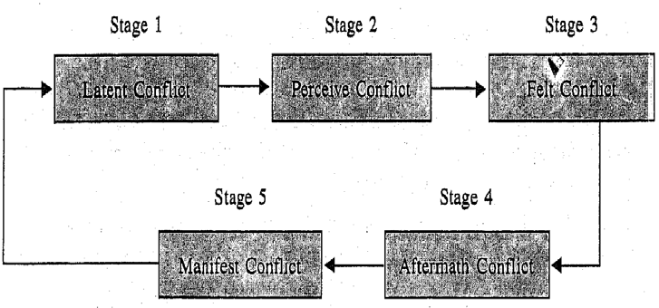
Conflict Process
Latent Conflict
Perceive Conflict
Felt Conflict
Manifest Conflict
Aftermath Conflict
Pondy's Model of Conflict

Slide 30
Conflict Process
Latent conflict:
It is the stage in which factors exist in the situation/ environment that may surface at any time.
For example limited resources are to be shared by many departments.
Potential source of conflict is present in the situation. It can erupt any time.
Notes:
Latent conflict: It is the stage in which factors exist in the situation/ environment that may surface at any time. For example limited resources are to be shared by many departments. Potential source of conflict is present in the situation. It can erupt any time.

Slide 31
Conflict Process
Perceived conflict:
At this stage people are aware that a conflict exists and the other party may frustrate one's goal directed behaviour.
For example, if quality manager is heard saying that we need to be more careful in certifying product as we have received many complaints from dealer about quality of the product.
Notes:
Perceived conflict: At this stage people are aware that a conflict exists and the other party may frustrate one's goal directed behaviour. For example, if quality manager is heard saying that we need to be more careful in certifying product as we have received many complaints from dealer about quality of the product. Overhearing this conversation production manager may become aware that there is a conflict as our product has to pass stringent quality standards, thus may reduce the volume of production. Thus production manager sees the possibility of development of conflict between the two departments.

Slide 32
Conflict Process
Felt conflict:
Parties to the conflict are emotionally aware that there is a conflict and they experience stress anxiety, stress, and hostility.
Managers of quality and production once called in GM's review meeting , they may feel the waves impending confrontations on production and quality issues and may prepare to state their stands on the conflict mentally.
Notes:
Felt conflict: Parties to the conflict are emotionally aware that there is a conflict and they experience stress anxiety, stress, and hostility. Managers of quality and production once called in GM's review meeting , they may feel the waves impending confrontations on production and quality issues and may prepare to state their stands on the conflict mentally.

Slide 33
Conflict Process
Manifest conflict:
At this stage open observable conflict is visible.
Quality manager now communicates his concern to production manager regarding the quality.
Production manager may react to the same by asking for specific data may or may not tribute to the usage obsolete technology.
But the fact is that conflict has come into open.
Notes:
Manifest conflict: At this stage open observable conflict is visible. Quality manager now communicates his concern to production manager regarding the quality. Production manager may react to the same by asking for specific data may or may not tribute to the usage obsolete technology. But the fact is that conflict has come into open.

Slide 34
Conflict Process
Conflict aftermath:
This is the fifth stage and ranges conflict resolution to group dissolution and group may return to stage one.
This is the stage where conflict resolution is attempted and once conflict is some how resolved using various strategies, parties to the conflict reach to stage where they are still left with residual hostility which among other things.
Notes:
Conflict aftermath: This is the fifth stage and ranges conflict resolution to group dissolution and group may return to stage one. This is the stage where conflict resolution is attempted and once conflict is some how resolved using various strategies, parties to the conflict reach to stage where they are still left with residual hostility which among other things become a reason for latent conflict in subsequent conflict episode.

Slide 35
Conflict Process
Another five stage conflict resolution process is proposed by Donelson Forsyth which may be used to understand task as well as process conflict. Features of each stage is given below:

Slide 36
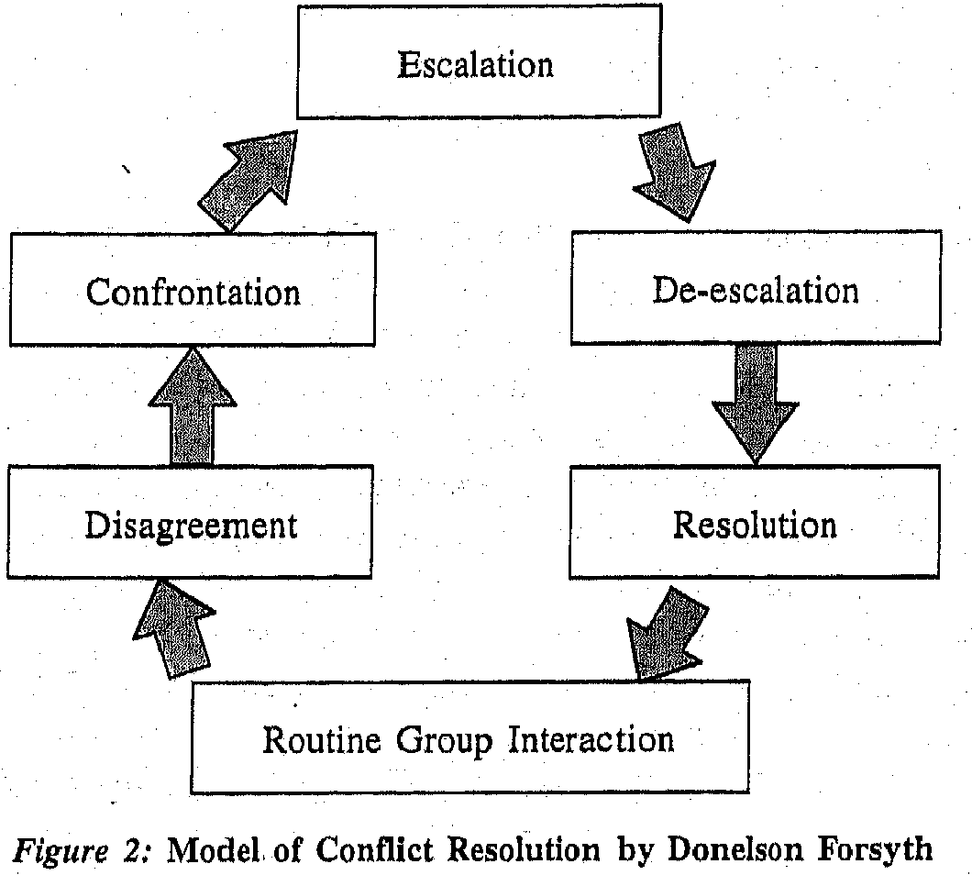
Conflict Process

Slide 37
Conflict Process
Disagreement:
Differences surface. Minor ones are resolved. People state I have changed my views, Some less critical issues are deferred.
Differences, perceived as real and substantive are acknowledged.
Notes:
Disagreement: Differences surface. Minor ones are resolved. People state I have changed my views, Some less critical issues are deferred. Differences, perceived as real and substantive are acknowledged.

Slide 38
Conflict Process
Confrontation:
One or more members of the groups when voice that they hold certain beliefs and values incompatible with that of other member and face clear opposition.
Members may also differ on goals or on mechanism of sharing of resources.
True conflict now exists. Debate happens.
Notes:
Confrontation: One or more members of the groups when voice that they hold certain beliefs and values incompatible with that of other member and face clear opposition. Members may also differ on goals or on mechanism of sharing of resources. True conflict now exists. Debate happens. A commitment to respective position intensifies. Emotions get aroused. Communication becomes less rational. Calls are given to neutrals to commit themselves.

Slide 39
Conflict Process
Confrontation:
One or more members of the groups when voice that they hold certain beliefs and values incompatible with that of other member and face clear opposition.
Members may also differ on goals or on mechanism of sharing of resources.
True conflict now exists. Debate happens.
Notes:
Confrontation: One or more members of the groups when voice that they hold certain beliefs and values incompatible with that of other member and face clear opposition. Members may also differ on goals or on mechanism of sharing of resources. True conflict now exists. Debate happens. A commitment to respective position intensifies. Emotions get aroused. Communication becomes less rational. Calls are given to neutrals to commit themselves.

Slide 40
Conflict Process
Escalation:
In this stage conflict give birth to further conflicts. People become more aggressive. Trust is lost.
Negative norms of reciprocity develops and forces an orientation " you will get what you give".
An eye, for an eye slogan becomes favorite at this phase.

Slide 41
Conflict Process
Deescalation:
While fighting at escalation stage, parties drain lot of their energy.
Emotions cool down. Some sense of rationality and understanding reemerges out of necessity.
Group protection norm emerges.
Trust May or may not develop depending on issue and intensity of disagreement.
Notes:
Deescalation: While fighting at escalation stage, parties drain lot of their energy. Emotions cool down. Some sense of rationality and understanding reemerges out of necessity. Group protection norm emerges. Trust May or may not develop depending on issue and intensity of disagreement. Negotiation, conciliation, or some kind of resolution may be initiated at this stage. Parties may agree to compromise or to look for broader perspective in the interest of the group. If nothing works third party may be invited for intervention. This intervention may be appropriate only when emotional intensity of the conflict has subsided parties are ready to listen.

Slide 42
Conflict Process
Resolution:
At this stage there is variety of activities in the group leading to resolution.
Group may change its stand, or minority members are sacrificed in the interest of larger group.
Members genuinely get persuaded.
A fraction of the group may withdraw seeing the futility of its efforts.
Notes:
Resolution: At this stage there is variety of activities in the group leading to resolution. Group may change its stand, or minority members are sacrificed in the interest of larger group. Members genuinely get persuaded. A fraction of the group may withdraw seeing the futility of its efforts. Leader may veto the decision and resolve the conflict. It may be resolved by votes. Negotiation and trading of favours may result in resolution.

Slide 43
Styles of Conflict Management
Five conflict management styles, Based on Blake and Mouton's Mangerial Grid model, five conflict management styles have been proposed, Two dimensions: concern for personal goals or assertiveness (the degree to which one party satisfies his/her own concerns) and concern for relationship (degree to which one tries to satisfy other party's concern) have been used to derive five styles:

Slide 44
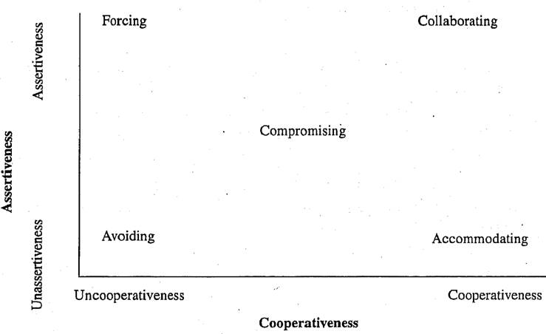
Styles of Conflict Management
Styles of Conflict Management

Slide 45
Styles of Conflict Management
Contingency approach to conflict management.
Derr proposed a contingency approach for choice conflict management strategies.
He suggested three main strategies of conflict management: power play, bargaining, and collaboration.
Notes:
Contingency approach to conflict management. Derr proposed a contingency approach for choice conflict management strategies. He suggested three main
strategies of conflict management: power play, bargaining, and collaboration. He suggested that collaboration is best suited when relationship between the parties is of interdependent nature, cost of unresolved conflict is very high and organization supports the open expression of disagreements and working on the same.
Bargaining works fine when parties are interested in showing power and is used as a mechanism to allocate scarce resources and usually invoked for arriving at a formal agreement. Bargaining is also effective in the situations where parties to disagreement use either collaboration or power play and fail to arrive an agreement , bargain works for them as a middle path.

Slide 46
Styles of Conflict Management
Bargaining works fine when parties are interested in showing power and is used as a mechanism to allocate scarce resources and usually invoked for arriving at a formal agreement.
Bargaining is also effective in the situations where parties to disagreement use either collaboration or power play and fail to arrive an agreement , bargain works for them as a middle path.

Slide 47
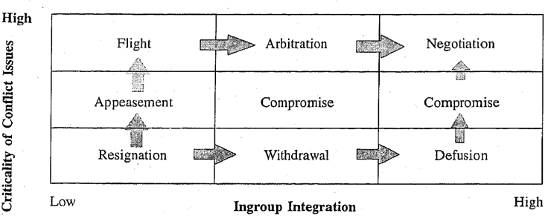
Styles of Conflict Management
Notes:
Power play is used to deal with conflicts through striking balance between competing forces. This strategy works well with people who are well versed in using power tactics.
Negotiation is the greatest weapon and used only when various processes have matured. It may not be always a desirable mode for resolving conflict. However, it is a constructive and approach mode of conflict management. Parties involved in conflict may consider to move towards negotiation mode eventually as negotiation recognises the power and willingness of both parties to resolve the problem in mutually beneficial way.
Two variables appear to influence choice of mode of influence of strategies. Integration of the ingroup and the criticality of the issue of conflict. If the group is not well integrated, negotiation may not be appropriate strategy to be used. If the group is internally divided the group conflict may further worsen under the threat of outgroup. A group would risk negotiation only when the issue of the conflict is very central to the group. Non-substantive issues may not get that much energy of the group. (Figure 4)
The two variables, integration of in group and criticality of the conflict may vary from low to high: As the two variables approach high, approach strategies of conflict management may become more relevant and eventually parties may move towards negotiation. Movement towards negotiation may be through compromise or through third party intervention who can facilitate the process of negotiation. Adoption of negotiation may be a gradual process and parties may take their own time to understand and proceed towards that.

Slide 48
Styles of Conflict Management
Pareek's Model of Conflict Management.
Uadi Pareek proposed a contingency model of conflict management strategies.
This model again consists of avoidance approach mode to conflict management.
In order to check your own preference to various conflict management strategy please do the following activity.
Notes:
Pa reek's Model of Conflict Management. Uadi Pareek proposed a contingency model of conflict management strategies. This model again consists of avoidance approach mode to conflict management. In order to check your own preference to various conflict management strategy please do the following activity.

Slide 49
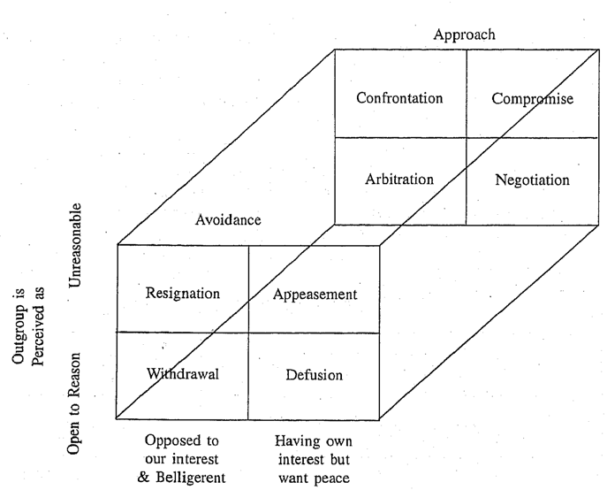
Styles of Conflict Management

Slide 50
Styles of Conflict Management
Activity 1
Before moving further please complete the following exercise.
Dialogue with conflicting party on the underlying problem and jointly search a mutually acceptable solution.
Workout your best solution for the conflict and fight your own way out to implement it.
Do nothing about the conflict, because no attempt usually help.
Notes:
Activity 1
Before moving further please complete the following exercise.
What approach do you follow in managing conflicts? Below are 8 approaches. Rank them interms of your own preference style of conflict management. Give rank 1 to the statement best describes your approach or style; 2 to the statement which is the next best description of your style and so on; thus the statement which is least true of your style will get rank 8.
Dialogue with conflicting party on the underlying problem and jointly search a mutually acceptable solution.
Workout your best solution for the conflict and fight your own way out to implement it.
Do nothing about the conflict, because no attempt usually help.
Use help of a third party for arbitration.
Allow some time to pass, hoping that things will cool down helping in solving the conflict
Provide small concession to the party
Avoid most situations that are likely to lead to conflicts.
In the spirit of give and take, accept some demands made by other party in the exchange of some your own demands.

Slide 51
Styles of Conflict Management
Activity 1
Before moving further please complete the following exercise.
Use help of a third party for arbitration.
Allow some time to pass, hoping that things will cool down helping in solving the conflict
Provide small concession to the party
Avoid most situations that are likely to lead to conflicts.
Notes:
Activity 1
Before moving further please complete the following exercise.
What approach do you follow in managing conflicts? Below are 8 approaches. Rank them interms of your own preference style of conflict management. Give rank 1 to the statement best describes your approach or style; 2 to the statement which is the next best description of your style and so on; thus the statement which is least true of your style will get rank 8.
Dialogue with conflicting party on the underlying problem and jointly search a mutually acceptable solution.
Workout your best solution for the conflict and fight your own way out to implement it.
Do nothing about the conflict, because no attempt usually help.
Use help of a third party for arbitration.
Allow some time to pass, hoping that things will cool down helping in solving the conflict
Provide small concession to the party
Avoid most situations that are likely to lead to conflicts.
In the spirit of give and take, accept some demands made by other party in the exchange of some your own demands.

Slide 52
Styles of Conflict Management
Activity 1
Before moving further please complete the following exercise.
In the spirit of give and take, accept some demands made by other party in the exchange of some your own demands.
Notes:
Activity 1
Before moving further please complete the following exercise.
What approach do you follow in managing conflicts? Below are 8 approaches. Rank them interms of your own preference style of conflict management. Give rank 1 to the statement best describes your approach or style; 2 to the statement which is the next best description of your style and so on; thus the statement which is least true of your style will get rank 8.
Dialogue with conflicting party on the underlying problem and jointly search a mutually acceptable solution.
Workout your best solution for the conflict and fight your own way out to implement it.
Do nothing about the conflict, because no attempt usually help.
Use help of a third party for arbitration.
Allow some time to pass, hoping that things will cool down helping in solving the conflict
Provide small concession to the party
Avoid most situations that are likely to lead to conflicts.
In the spirit of give and take, accept some demands made by other party in the exchange of some your own demands.

Slide 53
Styles of Conflict Management
Pareek has proposed a model of conflict management based on three variables.
Mode of conflict management: Avoidance vs Approach mode
Reasonableness of the outgroup: Open to reason vs Unreasonable
Interest in peace: Interested in peace vs Belligerent
Notes:
Pareek has proposed a model of conflict management based on three variables.
Mode of conflict management: Avoidance vs Approach mode
Reasonableness of the outgroup: Open to reason vs Unreasonable
Interest in peace: Interested in peace vs Belligerent

Slide 54
Styles of Conflict Management
Four avoidance styles.
Extreme avoidance of conflict happens when the out-group is belligerent and unreasonable, resultant approach is sense of helplessness.
However if the out-group is perceived interested in power, avoidance takes place so that there is minimum opportunity for interaction.
However, when out-group is perceived as open to reason, avoidance takes a positive form: withdrawal from the conflict.
Notes:
During the conflict situation ingroup and outgroup are addressed as we and they. Outgroup is considered to have interest opposed to ingroup and outgroup is also seen belligerent, then conflict seems to be inevitable, but if outgroup is perceived distracted or disinterested , conflict may not arise. Once conflict has surfaced, outgroup may be still perceived in two ways- open to reason (interested in listening, dialoguing and solving the problem) and unreasonable ( not amenable to logic ) thus a low probability of solution. A combination of three variables produces 8 styles of conflict management. (Figure 5) If we can determine where the parties/group is placed in the matrix of three variables, it can be predicted which style and mode of conflict management will be successful. Avoidance approach is based on fear result into defensive behaviour like rationalization, emotional displacement and anger. Approach mode is based on positive psychology characterised by effort to find solution with the help of others.
Four avoidance styles. Extreme avoidance of conflict happens when the out-group is belligerent and unreasonable, resultant approach is sense of helplessness. However if the out-group is perceived interested in power, avoidance takes place so that there is minimum opportunity for interaction. However, when out-group is perceived as open to reason, avoidance takes a positive form: withdrawal from the conflict. If both groups are interested in peace, they may suppress the conflict and hide hurt feelings and losses. In such situation, i.e, under avoidance mode, no conflicts get resolved.

Slide 55
Styles of Conflict Management
Four approach Styles.
Conflict management may vary from very aggressive approach to a very positive and constructive approach.
If in-group perceives the out group both as opposed to its interest and unreasonable, in-group members fight for solution in their favour.
Blake and Mouton called this `win-lose trap'.
This is where parties use confrontation style.
Notes:
Four approach. Styles. Conflict management may vary from very aggressive approach to a very positive and constructive approach. If in-group perceives the out group both as opposed to its interest and unreasonable, in-group members fight for solution in their favour. Blake and Mouton called this `win-lose trap'. This is where parties use confrontation style. If out-group is perceived as unreasonable but interested in peace, compromise is used. When out-group is, perceived as belligerent but open to reason, arbitration or third party intervention is considered appropriate. When parties are reasonable, having their own interest, and keen to arrive a peaceful solution, negotiation will be the most appropriate strategy.

Slide 56
Styles of Conflict Management
Result of Activity 1
Styles of the alternatives are as follows:
Negotiation
Confrontation
Resignation
Arbitration
Defusion
Appeasement

Slide 57
Styles of Conflict Management
Result of Activity 1
Styles of the alternatives are as follows:
Withdrawal
Compromise

